Slide 1
Image Classification of Cats and Dogs using CNN
Project Presentation
Presented By:
Pragya Kumari

Slide 2
CONTENTS:
ABSTRACT
INTRODUCTION
PROBLEM IDENTIFICATION
RESEARCH OBJECTIVES
PROPOSED WORK
RESULTS
CONCLUSION
FUTURE WORK

Slide 3
ABSTRACT
In this Research we give emphasis on the Image Classification of Cats and Dogs using CNN and the evolution of the various approaches adopted for this system by making use of the CNN model.
The main task which is involved in image classification is of extracting important features.
By using the important features of image processing methods, the image classification system can classify the results more efficiently and achieve high accuracy.
In this research, we have used Cats and Dogs Classification Kaggle Dataset of 25K training images and test images.

Slide 4
INTRODUCTION TO IMAGE CLASSIFICATION SYSTEM
Cats and dogs Image Classification is a method of identifying whether a given picture contains a cat or a dog. This classification system can be used to automatically sort or label pet images in photos, video, or in real-time.
Image Classification System use computer algorithms detect and analyze distinctive visual features such as fur patterns, ear shapes, and facial structures. These features are extracted and converted into a mathematical representation through a Convolutional Neural Network (CNN) and compared to learned data of cat and dogs collected in this system.

Slide 5
Problem Identification
Automatically locate the animal : Locating or detecting an animal in an image or video is the first step in a image classification system. Variations in image composition, background clutter, and different poses of animals make this task challenging.
Illumination : The difficulties posed by variable illumination conditions, therefore, remain a significant challenge for automatic image classification systems.
Pose and Orientation:
Cats and dogs may appear in different positions—sitting, lying down, stretching, or partially turned—causing significant variation in visible features and creating difficulty in consistent feature extraction.
Low Resolution : Low resolution problem occurs in an image classification system when resolution of the animal image to be recognized is lower.

Slide 6
Research Objectives
The aim of this research is to detect and locate animal in a color image using CNN.
The objective is to improve accuracy for the problems faced while recognizing animal images using Convolutional Neural Network (CNN).
The dataset used is Cats and Dogs Classification Dataset(Kaggle)

Slide 7
Proposed Work
In this research, we have used a Convolutional Neural Network (CNN) model and hosted it using Django.
The model first normalizes input images and then applies 2D Convolution followed by Max Pooling.
Each convolution block uses Rectified Linear Unit (ReLU) activation to learn non-linear patterns.
The extracted features are flattened and passed through Dense layers with ReLU, Batch Normalization, and Dropout.
Finally, we use a Sigmoid activation function in the output layer for binary classification.
The model is trained for multiple epochs, and results are evaluated using accuracy and loss curves.
We use Binary Cross-Entropy as the loss function for classification.
Performance is further validated with a Confusion Matrix and Classification Report.

Slide 8
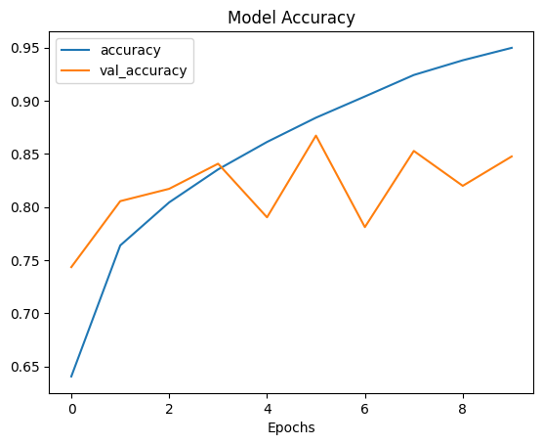
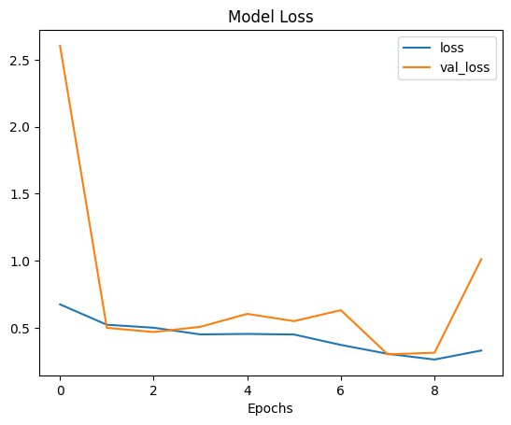
Results – Accuracy And Loss Graph

Slide 9
Results – Home Page

Slide 10
Results – Uploading Image

Slide 11
Results - After Prediction

Slide 12
CONCLUSION
In this research, We have improved accuracy for the problems faced while recognizing animal images using Django – Flask and CNN.
This project contains an interpretation to various CNN techniques which can be used to solve the problems while recognizing animal images.
Accuracy obtained by using CNN model on Cats and Dogs Classification Dataset (Kaggle) is 94%.
The conclusion that can be drawn from this research using the various type of Convolutional Neural Network method is that it is able to recognize animal images very efficiently and effectively.

Slide 13
FUTURE WORK
In Future ,We will integrate Image Classification System with Amazon Web Services (AWS) so that it can be more efficient ,safer and provide enhanced security and provides faster computing
Cloud Computing provide various feature like Scalability ,Virtualization, Allows pay-per-use , High Speed and increasing Virtual Demand in today world makes it a must to do while implementing Image Classification System.
Therefore, in future, it is interesting to study on how to reduce the time and cost of above-mentioned algorithms , so that we can design an efficient Image Classification System

Slide 14


